Slide 1
British Airways Airline Review Analysis
Jason Mullen

Slide 2


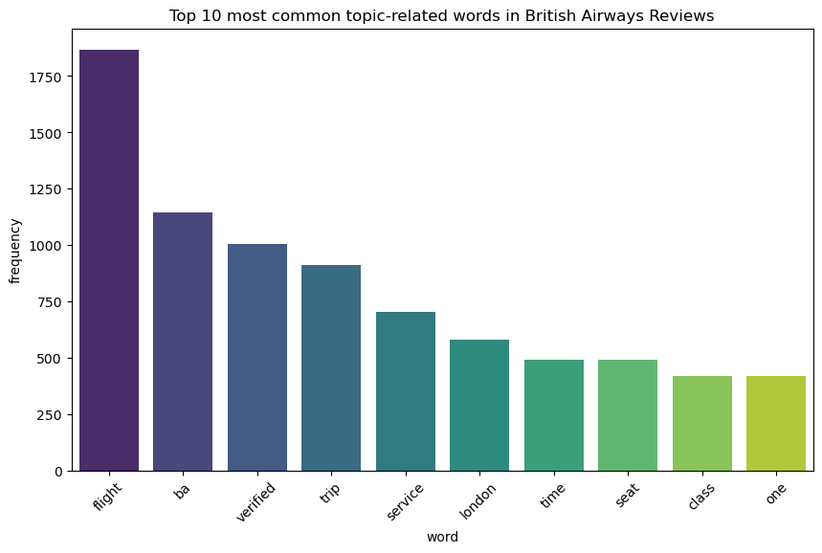

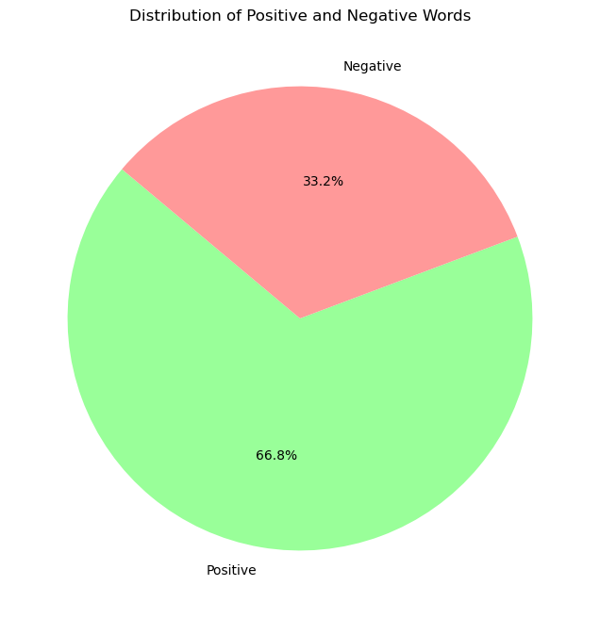
Results
Key topics:
We can see that in the customer reviews that the most used word was ”flight.”
Sentiments:
The pie chart shows us that 66.8% of the reviews were positive while 33.2% were negative.

